Slide 1


Dhole Patil Education Society’s Dhole Patil College of Engineering, Pune
Mini Project Presentation
Project Title: ROBOT ARM USING IMAGE PROCESSING
Under the Guidance of : Prof. Dhananjay Poul
Presentation by : 1] Mayur Ichake (T400600197)
2] Sahil Ichake (T400600198)
3] Aditya Mungase (T400600160)
A.Y. 2024-25

Slide 2
Dhole Patil Education Society’s Dhole Patil College of Engineering, Pune
Presentation Flow
Introduction, Project Objective,Goal
Literature Survey
Block Diagram
Specification
Implementation Details
Circuit Diagram
Results
Advantages & Applications
Conclusion, Future Scope
References

Slide 3
Dhole Patil Education Society’s Dhole Patil College of Engineering, Pune
INTRODUCTION
Project Objective :This project focuses on the design and development of a robotic arm specifically tailored for cutting vegetables directly from trees, aiming to minimize human effort, enhance productivity, and ensure consistent harvesting quality.
Technology Used: In this we use Arduino and Servo Motors and image processing camera.
Key Features : Automatically identify good and ripped vegetables and cut harvested from tree .
Goal: Develop a cost-effective and efficient robotic arm prototype suitable for real-world agricultural environments and vegetable cutting automatically.

Slide 4
Dhole Patil Education Society’s Dhole Patil College of Engineering, Pune
ABSTRACT
This project presents the design and development of a robotic arm system intended for the automated harvesting of vegetables directly from trees. Traditional methods of vegetable harvesting are labor-intensive, time-consuming, and often result in damage to the produce or plant. The proposed system aims to address these challenges by integrating mechanical, electronic, and software technologies into a compact and efficient robotic solution.

Slide 5


Dhole Patil Education Society’s Dhole Patil College of Engineering, Pune
LITERATURE SURVEY
The application of robotics in agriculture has grown significantly in recent years, aiming to enhance productivity, reduce manual labor, and promote precision farming. Several studies and developments have been conducted in the area of robotic arms and automated harvesting systems.
1. Robotic Harvesting Systems
Robotic harvesting systems have been implemented in various agricultural sectors, particularly for crops like strawberries, tomatoes, and apples. Researchers have designed robotic arms equipped with cameras and grippers to identify and harvest fruits with minimal damage. These systems rely heavily on machine vision and sensor integration for successful operation. For instance, the work by Bac et al. (2014) demonstrated a sweet pepper harvesting robot using a combination of image processing and motion planning.

Slide 6
Dhole Patil Education Society’s Dhole Patil College of Engineering, Pune
SPECIFICATIONS
Microcontroller: Arduino Mega
Servo Device: PCA9685 servo driver
Servo Motor: 5V,5A (power supply)
Adapter : 5v
3D Printed Robotic Arm
Jumper Wires

Slide 7
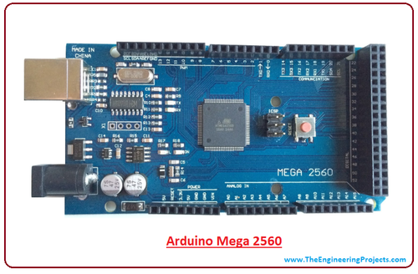
Dhole Patil Education Society’s Dhole Patil College of Engineering, Pune
ARDUINO (MEGA)
Uses the ATmega2560 microcontroller.
Runs at a clock speed of 16 MHz.
Features a USB Type-B port for programming and power supply.
Programmed using Arduino IDE with C/C++ language.
Suitable for beginners and advanced users in DIY, robotics, and IoT projects.

Slide 8
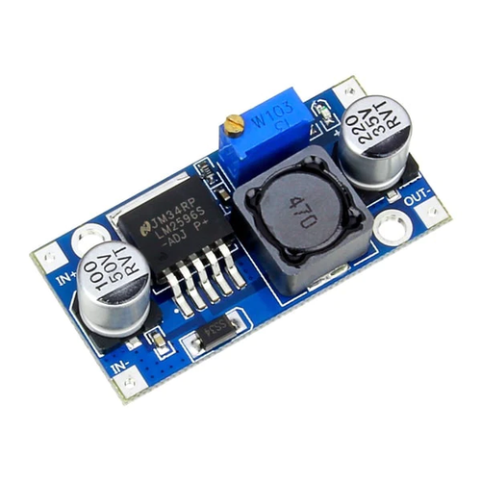
Dhole Patil Education Society’s Dhole Patil College of Engineering, Pune
LM2596
Input Voltage Range: 4V to 40V DC.
Adjustable Output Voltage: 1.25V to 37V DC
Maximum Output Current: Up to 3A with proper cooling..
High Efficiency up to 90%
Switching Frequency: 150 kHz for fast response and compact size.
Built-in Protections: Thermal shutdown and current limiting..
Compatible with Arduino.

Slide 9
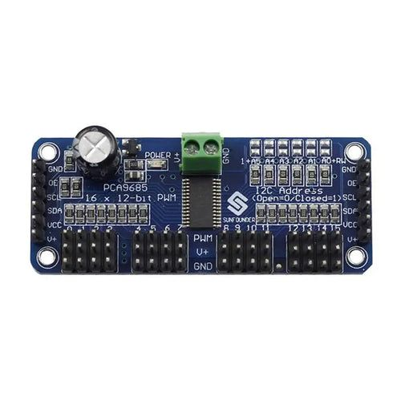
Dhole Patil Education Society’s Dhole Patil College of Engineering, Pune
PCA9685
16-Channel PWM Output: Controls up to 16 servos or LEDs independently.
12-Bit Resolution: Provides 4096 steps for precise PWM control.
Operating voltage 2.3 to 5v.
Frequency Range: PWM frequency adjustable from ~24 Hz to 1526 Hz.
Stackable Addressing: Up to 62 PCA9685 modules on one I²C bus

Slide 10
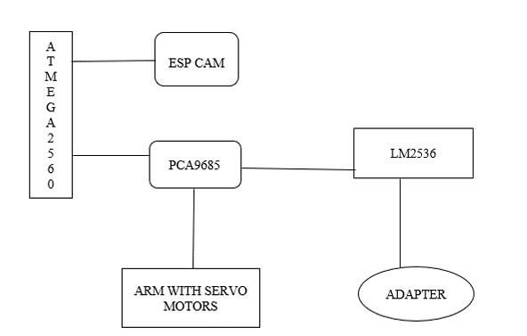
Dhole Patil Education Society’s Dhole Patil College of Engineering, Pune
Block Diagramm

Slide 11
Dhole Patil Education Society’s Dhole Patil College of Engineering, Pune
IMPLIMENTAION DETAIL
Hardware Setup:
LM2596: Steps down 12V to 5V/6V for servos and Arduino.
PCA9685: Controls up to 16 servo motors via I2C .
Arduino Mega (ATmega2560): Main controller, receives input and controls arm.
ESP32-CAM: Detects Fruit, sends signal to Mega via UART (or WiFi).
Servos: Connected to PCA9685 channels for robotic arm joints and cutter.
Power: Common ground for all components.

Slide 12
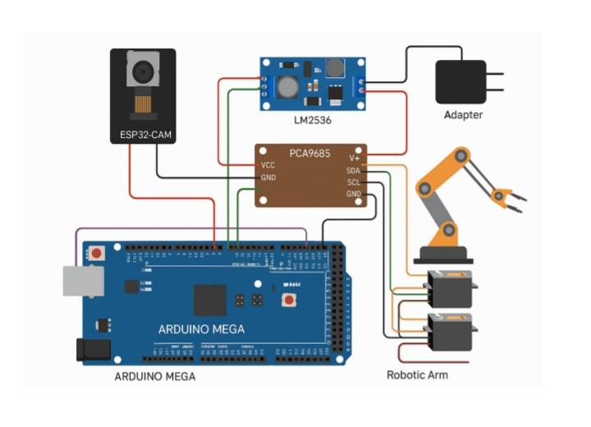
Dhole Patil Education Society’s Dhole Patil College of Engineering, Pune
CIRCUIT DIAGRAM

Slide 13


Dhole Patil Education Society’s Dhole Patil College of Engineering, Pune
RESULTS
The robotic arm project for automated fruit and vegetable harvesting successfully demonstrated the integration of image processing with mechanical actuation to perform selective picking. Utilizing an camera module, the system could identify ripe fruits based on color and shape features, processed in real-time using an ESP32 microcontroller. Once a target fruit was detected, the robotic arm was guided through coordinated movements to reach, grip, and harvest it with precision. The implementation significantly reduced manual labor, improved consistency in harvesting, and minimized damage to crops. Overall, the system showcased a promising solution for smart agriculture, with potential for further development through AI-based detection, enhanced mobility, and scalability for different crop types.

Slide 14
Dhole Patil Education Society’s Dhole Patil College of Engineering, Pune
ADVANTAGES
Reduces Manual Labor.
Increases Efficiency and Speed.
Improves Harvest Quality.
Don’t require to works in Harsh or Risky Environments.
Reduces Harvesting Costs.

Slide 15
Dhole Patil Education Society’s Dhole Patil College of Engineering, Pune
APPLICATION
Automated Harvesting in Agriculture.
Harvester machine.
Agricultural Research and Experimentation.
Labor-Scarce Rural Areas.
Custom Farming Services.

Slide 16
Dhole Patil Education Society’s Dhole Patil College of Engineering, Pune
FUTURE SCOPE
Implementation of solar panels for sustainable energy.
Integration with IoT.
Automated Harvesting.
Integration of Artificial Intelligence (AI).
Scalability for Commercial Farming.
Multi-Crop Adaptability

Slide 17
Dhole Patil Education Society’s Dhole Patil College of Engineering, Pune
CONCLUSION
The development of a robotic arm for vegetable cutting from trees represents a significant step toward the modernization and automation of agricultural practices. By combining mechanical engineering, electronics, and intelligent control systems, the proposed design addresses key challenges in manual harvesting such as labor dependency, time consumption, and the potential for damage to crops.
The project successfully demonstrates a prototype capable of detecting vegetables using image processing, accurately positioning itself using sensor data, and executing precise cuts using a motorized end-effector. The integration of technologies like machine vision, servo-controlled articulation, ensures that the robotic system can function effectively in a semi-structured farm environment.

Slide 18
Dhole Patil Education Society’s Dhole Patil College of Engineering, Pune
REFRENCES
[1] “Automated Harvesting of Fruits using Robotics and Machine Vision,” Journal of Robotics and Automation in Agriculture, Volume 3, Issue 2, April 2017.
[2] “Real-Time Image Processing for Fruit Detection in Agricultural Robotics,” International Journal of Agricultural Engineering, Volume 14, Issue 1, June 2015
[3] “Implementation of PWM Servo Motor Control for Robotics,” Journal of Mechatronics and Automation, Volume 12, Issue 8, September 2013.
[4] https://www.arduino.cc/en/Guide/ArduinoMega2560 (Accessed: April 2025)
[5] https://www.robotshop.com/en/servo-motors.html (Accessed: March 2015)
[6] https://www.tescaglobal.com/en/pca9685.html (Accessed: July 2016)

Slide 19
Dhole Patil Education Society’s Dhole Patil College of Engineering, Pune
Thank You

